Slide 1
Used Car Price Prediction Project Presentation
Submitted by Mohini Singh

Slide 2
ACKNOWLEDGMENT
I would like to express my deepest gratitude to my SME (Subject Matter Expert) Srishti Maan as well as Flip Robo Technologies who gave me the opportunity to do this project on Used Car Price Prediction, which also helped me in doing lots of research wherein I came to know about so many new things especially the data collection part.
Also, I have utilized a few external resources that helped me to complete the project. I ensured that I learn from the samples and modify things according to my project requirement.

Slide 3
ACKNOWLEDGMENT
All the external resources that were used in creating this project are listed below:
1) https://www.google.com/
2) https://www.youtube.com/
3) https://scikit-learn.org/stable/user_guide.html
4) https://github.com/
5) https://www.kaggle.com/
6) https://medium.com/
7) https://towardsdatascience.com/
8) https://www.analyticsvidhya.com/

Slide 4

PROBLEM STATEMENT
With the covid 19 impact in the market, we have seen lot of changes in the car market. Now some cars are in demand hence making them costly and some are not in demand hence cheaper. One of our clients works with small traders, who sell used cars. With the change in market due to covid 19 impact, our client is facing problems with their previous car price valuation machine learning models. So, they are looking for new machine learning models from new data. We have to make car price valuation model.

Slide 5
DATA COLLECTION PHASE
You have to scrape at least 5000 used cars data. You can scrape more data as well, it’s up to you. more the data better the model
In this section You need to scrape the data of used cars from websites (OLX, Car Dekho, Cars 24 etc.) You need web scraping for this. You have to fetch data for different locations. The number of
columns for data doesn’t have limit, it’s up to you and your creativity. Generally, these columns are Brand, model, variant, manufacturing year, driven kilometers, fuel, number of owners, location and at last target variable Price of the car. This data is to give you a hint about important variables in used car model. You can make changes to it, you can add or you can remove some columns, it completely depends on the website from which you are fetching the data.
Try to include all types of cars in your data for example- SUV, Sedans, Coupe, minivan, Hatchback.

Slide 6
MODEL BUILDING PHASE
After collecting the data, you need to build a machine learning model. Before model building do all data pre-processing steps. Try different models with different hyper parameters and select the best model. Follow the complete life cycle of data science. Include all the steps below.
1. Data Cleaning
2. Exploratory Data Analysis
3. Data Pre-processing
4. Model Building
5. Model Evaluation
6. Selecting the best model

Slide 7
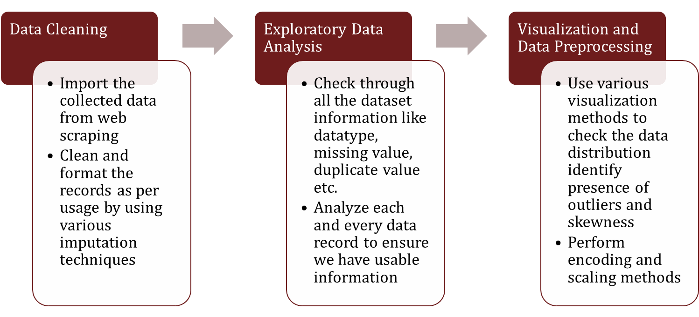
DATA SCIENCE LIFE CYCLE

Slide 8
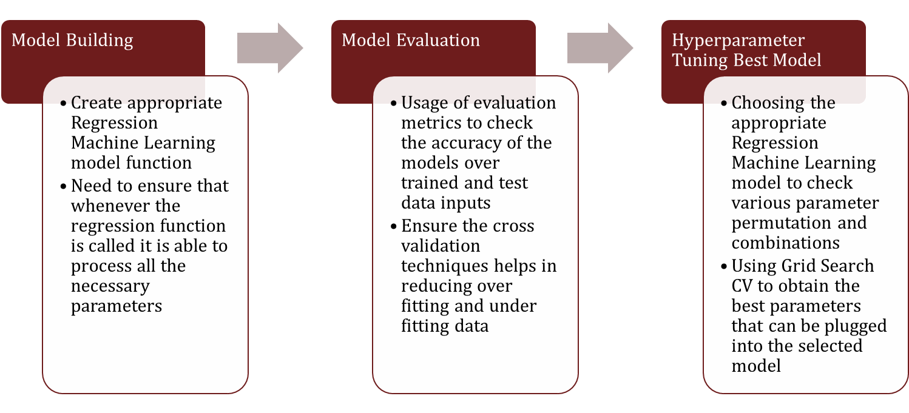
DATA SCIENCE LIFE CYCLE

Slide 9
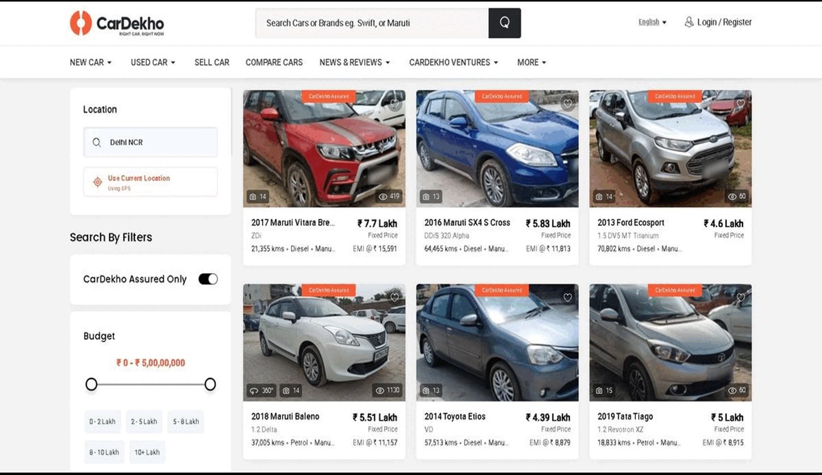
WEB SCRAPING FOR USED CAR DETAILS

Slide 10
DATA PREPROCESSING
Importing the necessary dependencies and libraries.
Reading the CSV file and converted into data frame.
Checking the data dimensions for the original dataset.
Looking for null values and accordingly fill the missing data.
Checking the summary of the dataset.
Checking unique values.
Checking all the categorical columns in the dataset.

Slide 11
DATA PREPROCESSING
Visualizing each features using matplotlib and seaborn.
Performing encoding using the ordinal encoder on categorical features.
Checking for co-relation/multi-collinearity in a heatmap.
Checking for Outliers/Skewness using boxen plot and distribution plot.
Perform Scaling using Standard Scaler method.
Checking for the final dimension of dataset to confirm the input details.
Creating train test split and the best random state found in the range 1-1000.

Slide 12
TECHNOLOGY USED
Hardware technology being used.
RAM : 8 GB
CPU : AMD Ryzen 5 3550H with Radeon Vega Mobile Gfx 2.10 GHz
GPU : AMD Radeon ™ Vega 8 Graphics and NVIDIA GeForce GTX 1650 Ti
Software technology being used.
Programming language : Python
Distribution : Anaconda Navigator
Browser based language shell : Jupyter Notebook
Libraries/Packages specifically being used.
Pandas, NumPy, matplotlib, seaborn, scikit-learn, pandas-profiling, missingno

Slide 13
EXPLORATORY DATA ANALYSIS (EDA) AND VISUALIZATION
Univariate Analysis
Univariate analysis is the simplest form of analyzing data. “Uni” means “one”, so in other words your data has only one variable.
02. Multivariate Analysis
03. Correlation of Dataset
Multivariate analysis is a set of statistical techniques used for analysis of data that contain more than one variable.
Correlation is used to test relationships between quantitative variables or categorical variables.
04. Correlation with Target variable
05. Conclusion
Correlation with the target variable to know how the data is related.
Summary with the conclusion of all the analysis

Slide 14
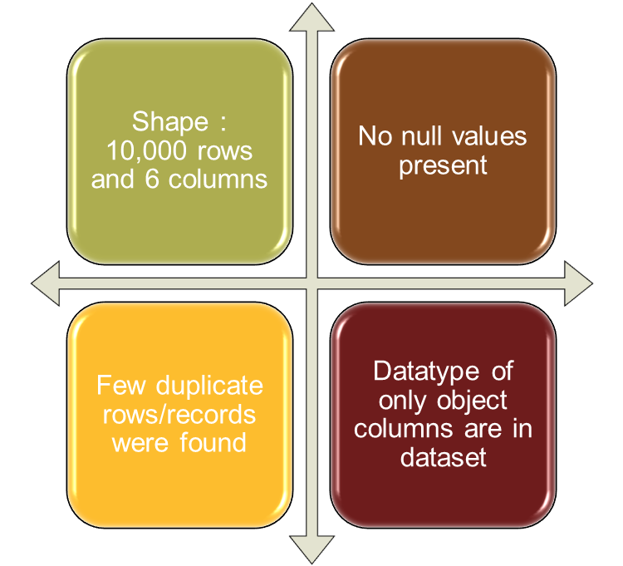
EXPLORATORY DATA ANALYSIS (EDA)
First I have imported the necessary libraries and loaded the entire dataset in our Jupyter Notebook and renamed the project file from untitled.
Then I checked the shape of our dataset and found that we have a total of 10,000 rows and 6 different columns.
We don’t have any null values or missing values present in our dataset from the web scraping.
There few duplicate rows/records in our dataset but I decided to retain them instead of deleting it.
By checking the data types I came to know that our data set consists of columns having only object datatype even those there were numeric information present.

Slide 15
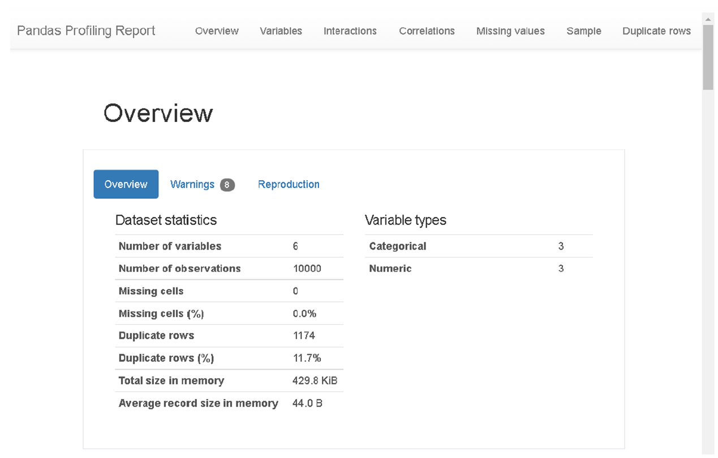
VISUALIZATION USING PANDAS PROFILING REPORT

Slide 16
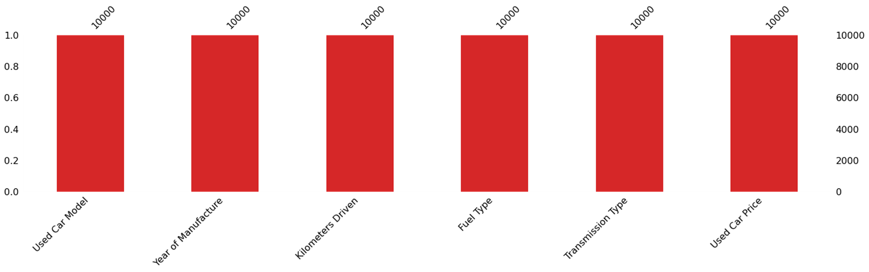
MISSING VALUES VISUAL USING MISSINGNO

Slide 17
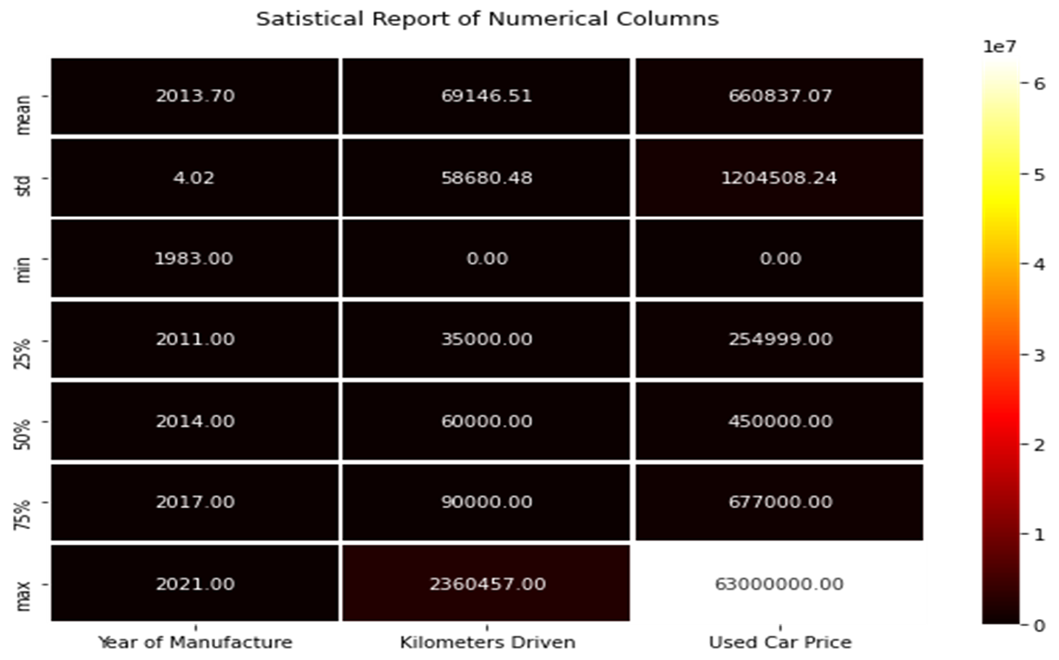
DESCRIBE DATASET VISUAL ON NUMERIC DATA

Slide 18
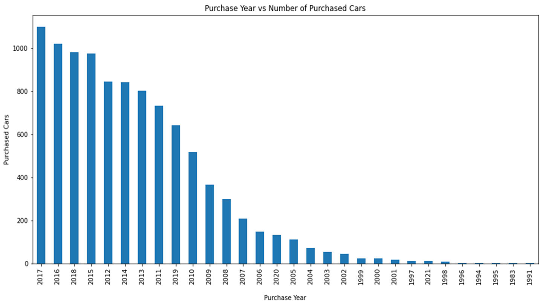
PURCHASE DETAILS OF USED CARS EACH YEAR

Slide 19
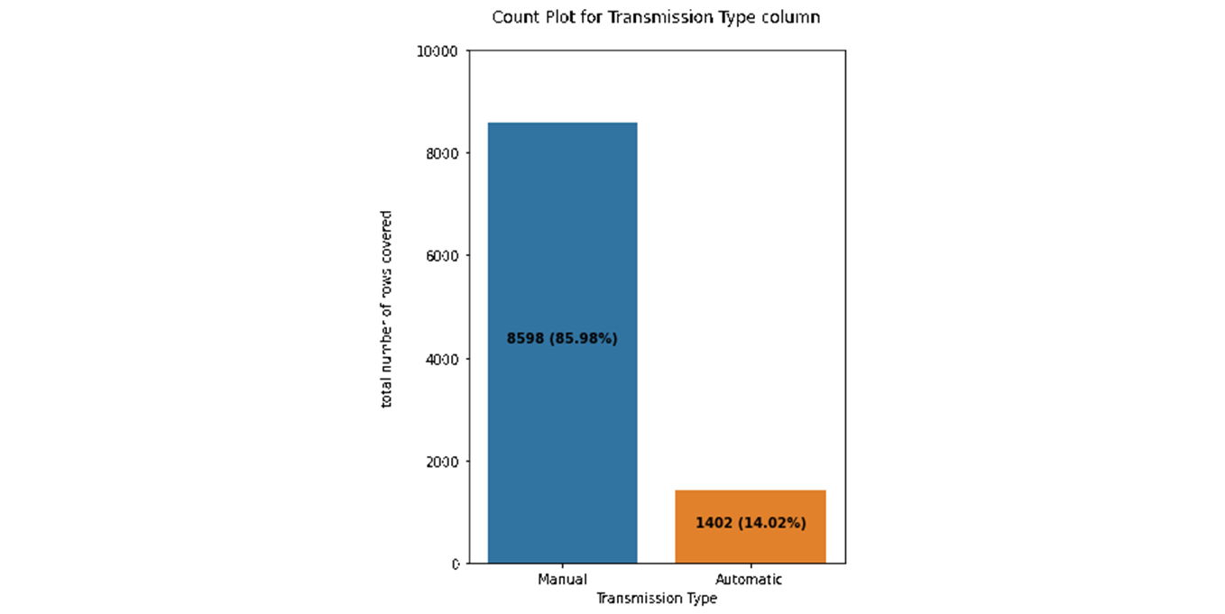
COUNT PLOTS

Slide 20
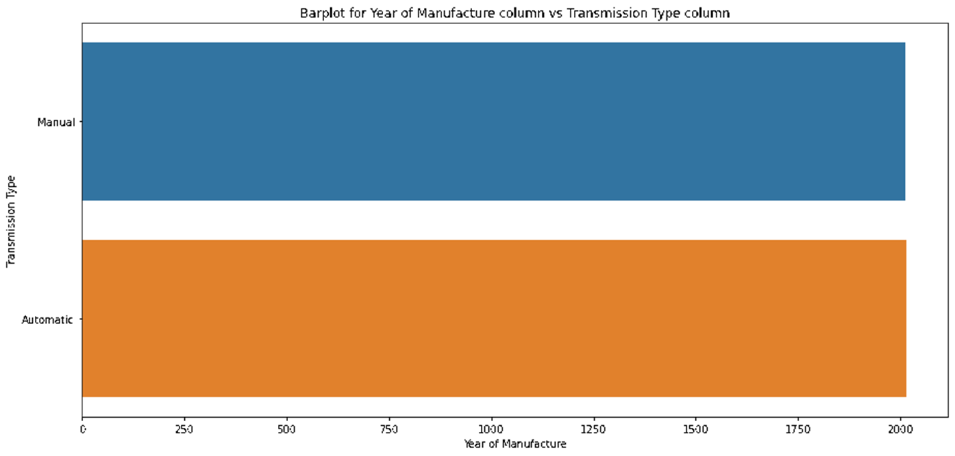
BAR PLOTS

Slide 21
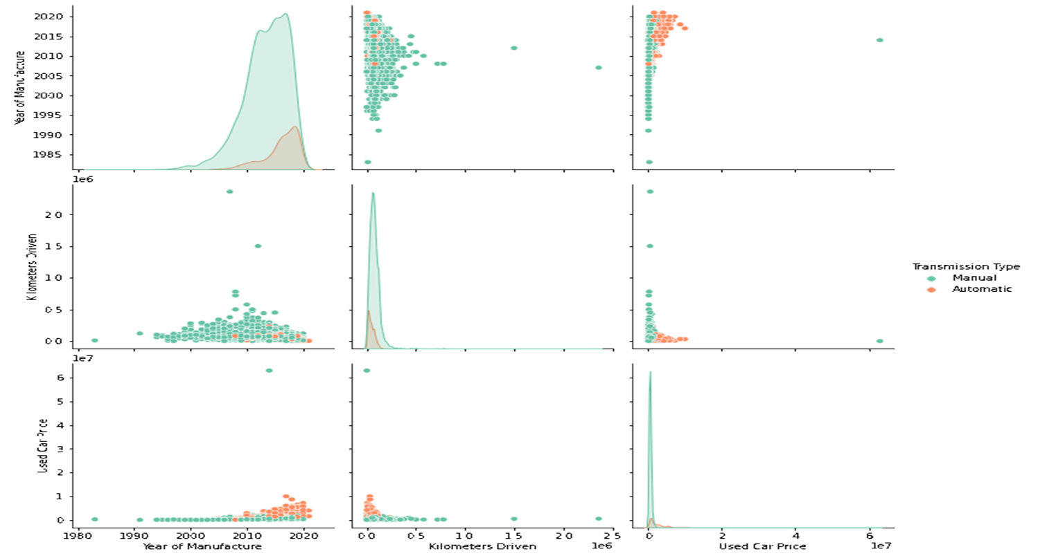
PAIR PLOTS

Slide 22
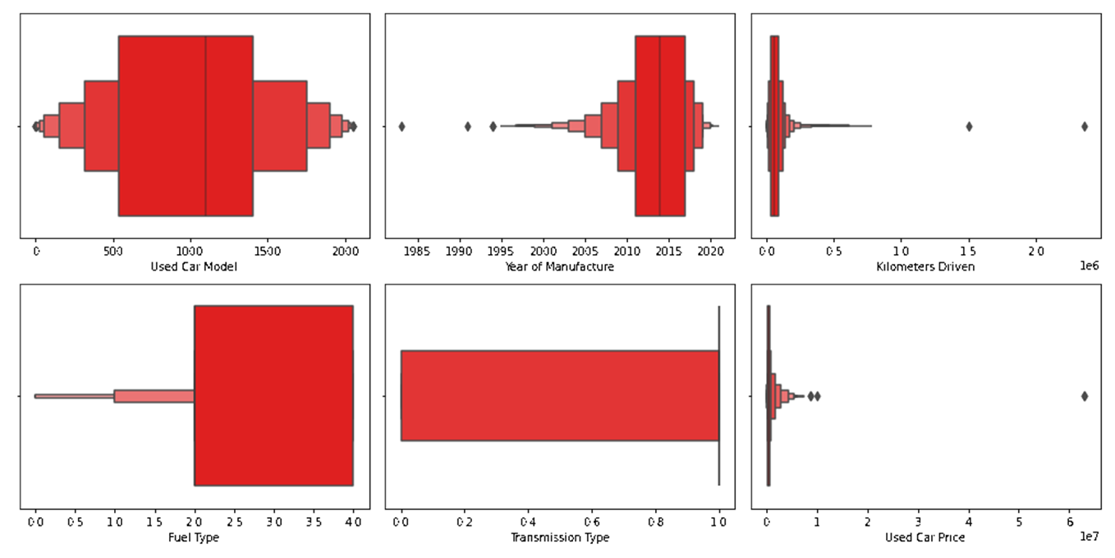
OUTLIERS WITH BOXEN PLOTS

Slide 23
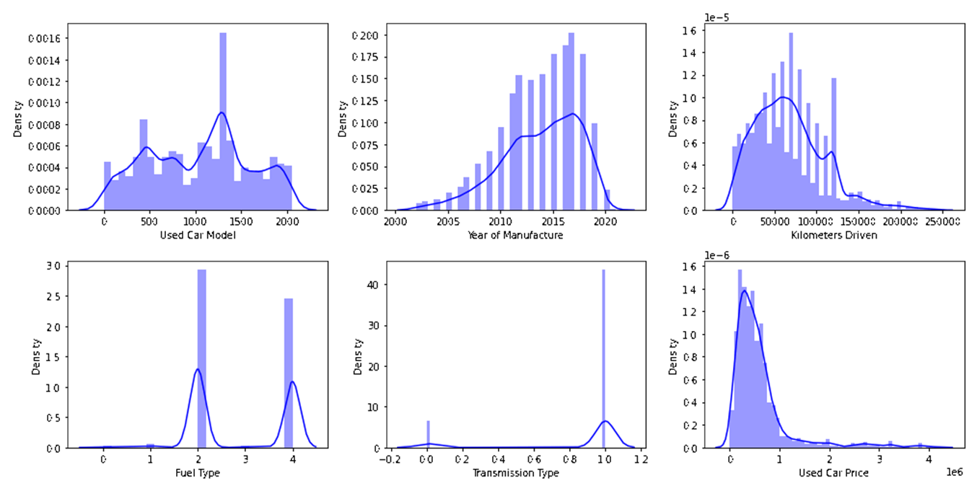
SKEWNESS WITH DISTRIBUTION PLOTS

Slide 24
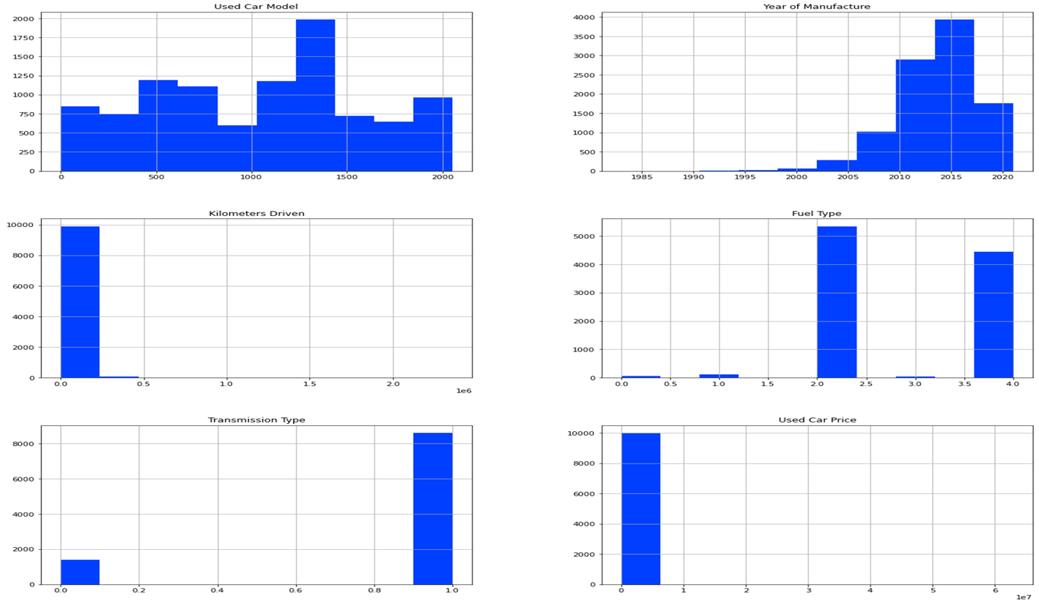
HISTOGRAM

Slide 25
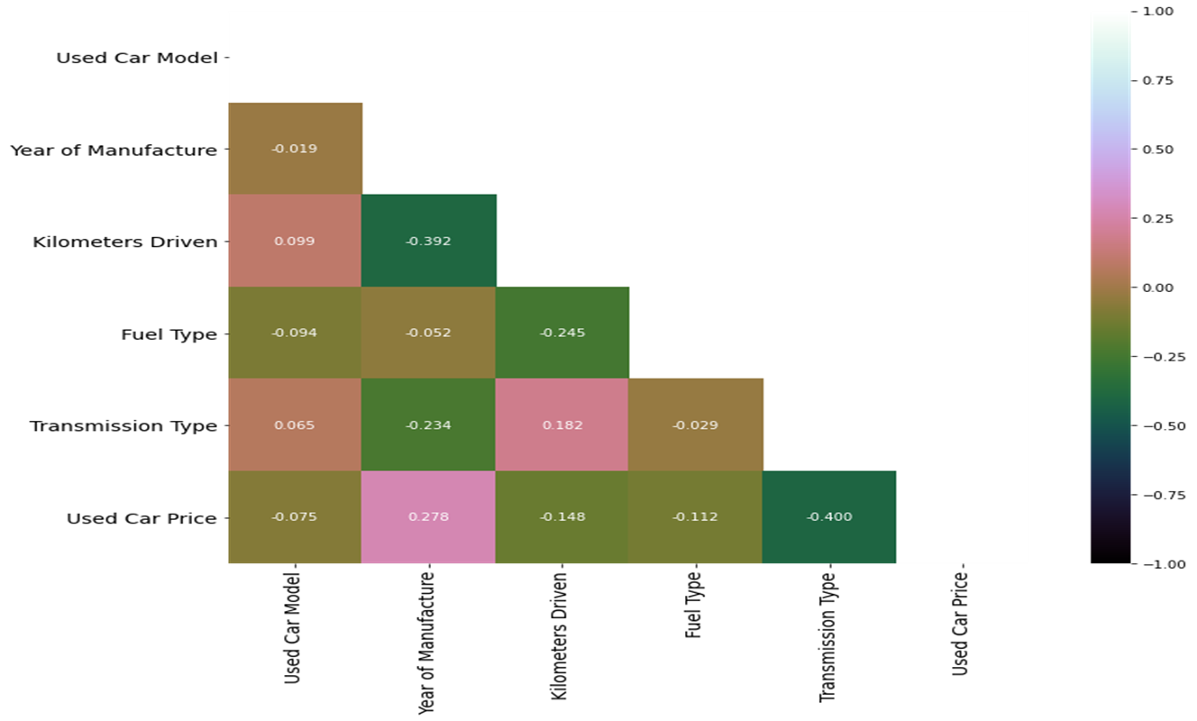
HEAT MAP

Slide 26
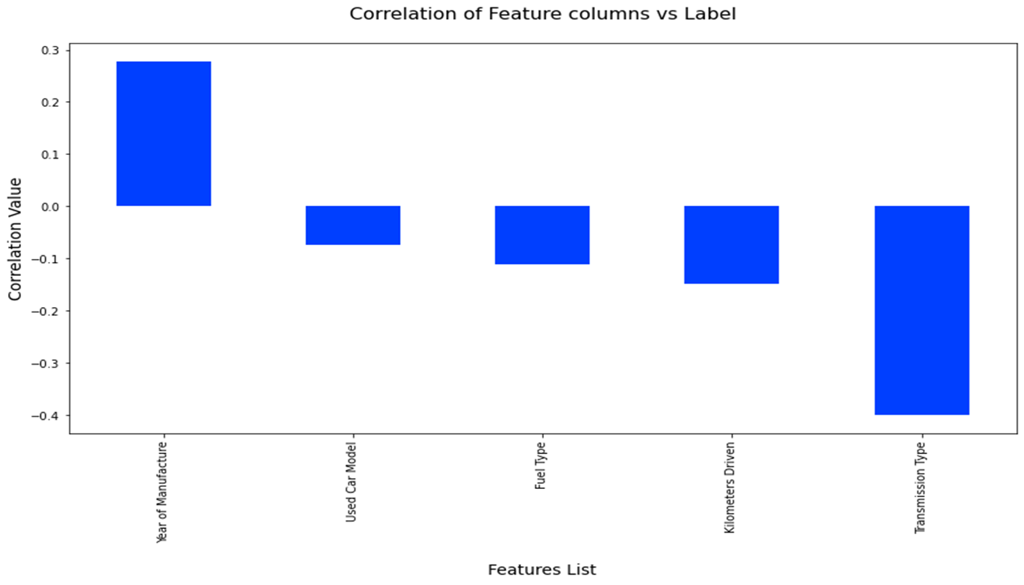
CORRELATIONS BAR GRAPH

Slide 27
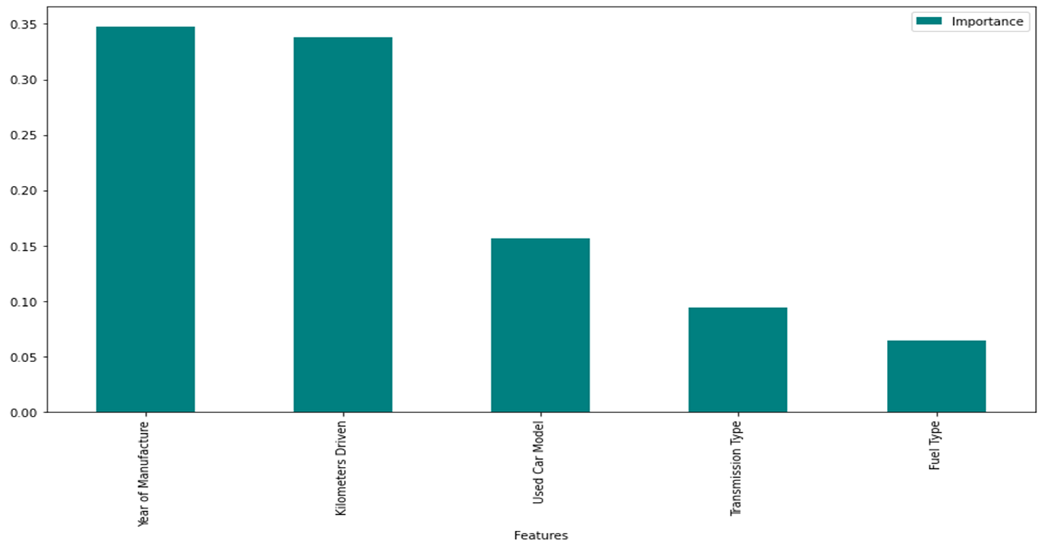
FEATURE IMPORTANCE BAR GRAPH

Slide 28

MODEL TRAINING PHASES

Slide 29
REGRESSION MACHINE LEARNING MODEL/S USED
▪ Linear Regression Model
▪ Ridge Regularization Model
▪ Lasso Regularization Model
▪ Support Vector Regression Model
▪ Decision Tree Regression Model
▪ Random Forest Regression Model
▪ K Neighbours Regression Model
▪ Gradient Boosting Regression Model
▪ Ada Boost Regression Model
▪ Extra Trees Regression Model

Slide 30
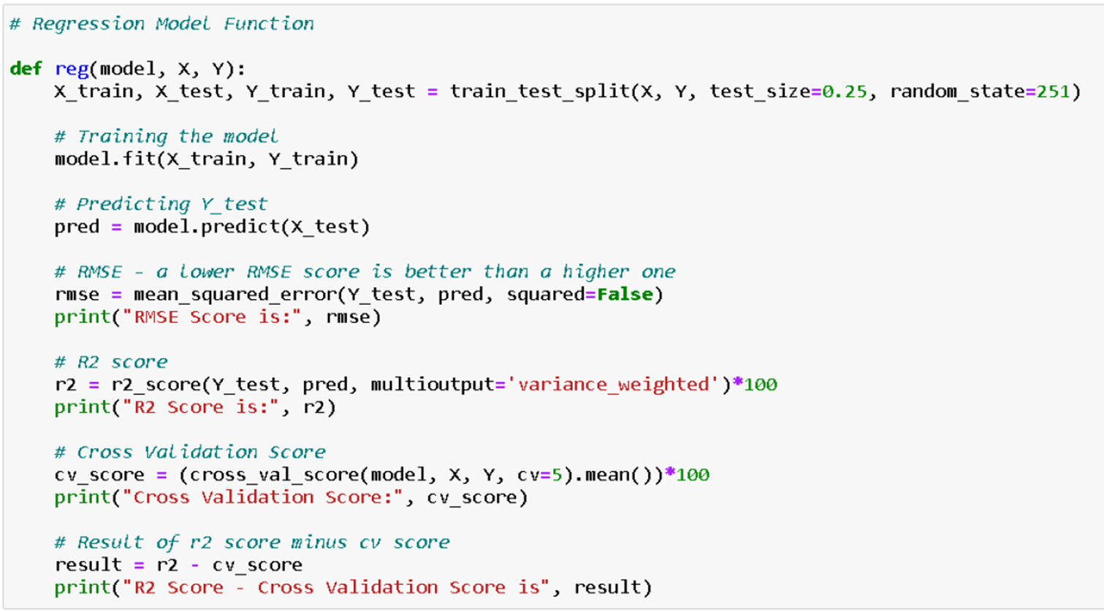
REGRESSION MODEL FUNCTION WITH EVALUATION METRICS

Slide 31
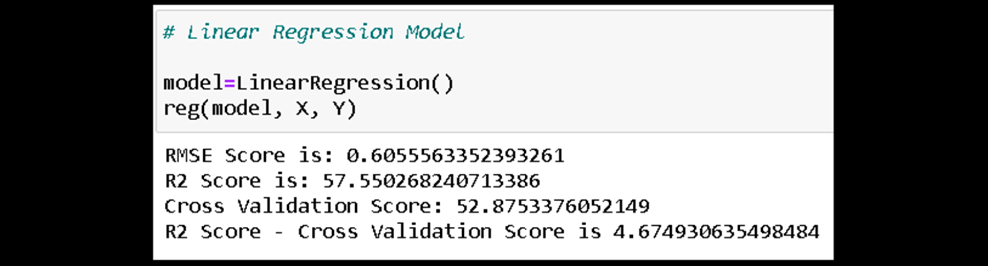
RESULT OF MULTIPLE REGRESSION MODELS

Slide 32
EVALUATION AND HYPER PARAMETER TUNING
The key metrics used here were:
R2 score
Cross Validation Score
MAE
MSE
RMSE
We tried to find out the best parameters list to increase our accuracy scores by using Hyperparameter Tuning. In order to achieve a higher score we used the Grid Search CV method with 5 folds.

Slide 33
CONCLUSION
After the completion of this project, we got an insight on how to collect data, pre-processing the data, analyzing the data and building a model. First, we collected the used cars data from different websites like OLX, Car Dekho, Cars 24, OLA etc. and it was done by using Web Scraping.
The framework used for web scraping was Beautiful Soup and Selenium, which has an advantage of automating our process of collecting data. We collected almost 10000 of data which contained the selling price and other related features of used cars. Then the scrapped data was combined in a single data frame and saved in a csv file so that we can open it and analyze the data.

Slide 34
CONCLUSION
We did data cleaning, data pre-processing steps like finding and handling null values, removing words from numbers, converting object to int type, data visualization, handling outliers and skewness etc. After separating our train and test data, we started running different machine learning regression algorithms to find out the best performing model.
We found that Extra Tree Regressor Algorithm was performing well according to their r2_score and cross validation scores. Then we performed Hyperparameter Tuning technique using Grid Search CV for getting the best parameters and improving the score. In that Extra Tree Regressor Algorithm did not perform quite well as previously on the defaults but we finalized that model for further predictions as it was still better than the rest. We saved the final model in pkl format using the joblib library after getting a dataframe of predicted and actual used car price details.

Slide 35
LIMITATIONS OF THIS WORK AND SCOPE FOR FUTURE WORK
The limitations we faced during this project were:
The website was poorly designed because the scrapping took a lot of time and there were many issues in accessing to next page. Also need further practice in terms of various web scraping techniques. More negative correlated data were present than the positive correlated one's. Presence of outliers and skewness were detected and while dealing with them we had to lose a bit of valuable data. No information for handling these fast-paced websites were provided so that was consuming more time in web scraping part.
Future Work Scope:
Current model is limited to used car data but this can further be improved for other sectors of automobiles by training the model accordingly. The overall score can also be improved further by training the model with more specific data.

Slide 36


